Slide 1
Appendix D Mapping Control to Hardware
Copyright © 2014 Elsevier Inc. All rights reserved.

Slide 2
The longest cycle is divided into 5 smaller cycles
IF: Instruction Fetch from memory (IF)
ID: Instruction Decode & register read (ID)
EX: EXecute operation or calculate address (EX)
MEM: Access MEMory operand (MEM)
WB: Write result Back to register (WB)
common
R-Type: add $a, $b, $c – 1-2-3-5
Load: lw $a, offset ($b) – 1-2-3-4-5
Store: st $a, offset ($b) – 1-2-3-4
Branch: beq $a, $b, L1 – 1-2-3

Slide 3
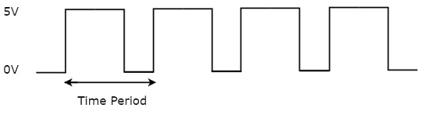
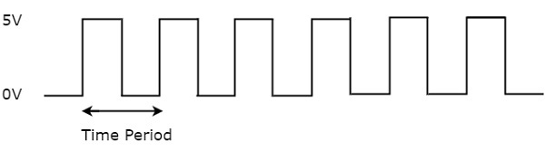
Multiclock Cycle Design
All control signals generated at the same time
Control signals generated at different times in different cycles

Slide 4
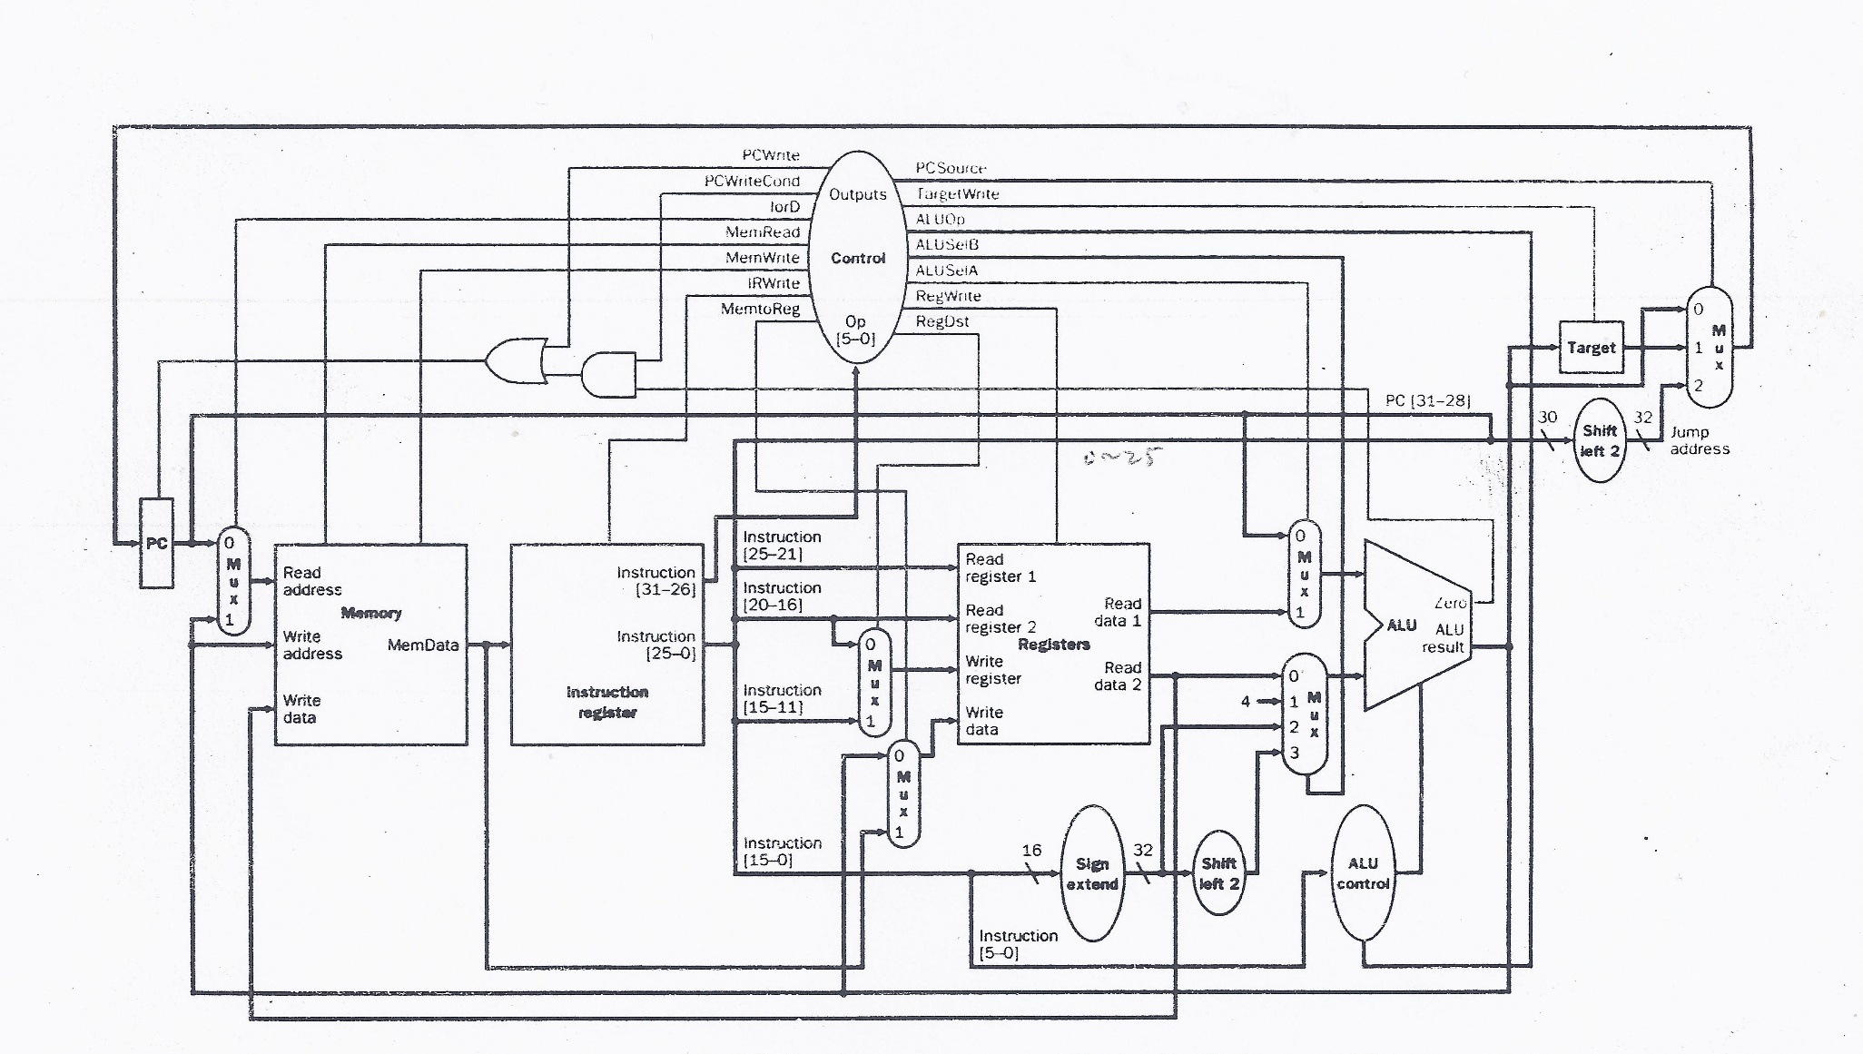
Multiclock Cycle Datapath

Slide 5
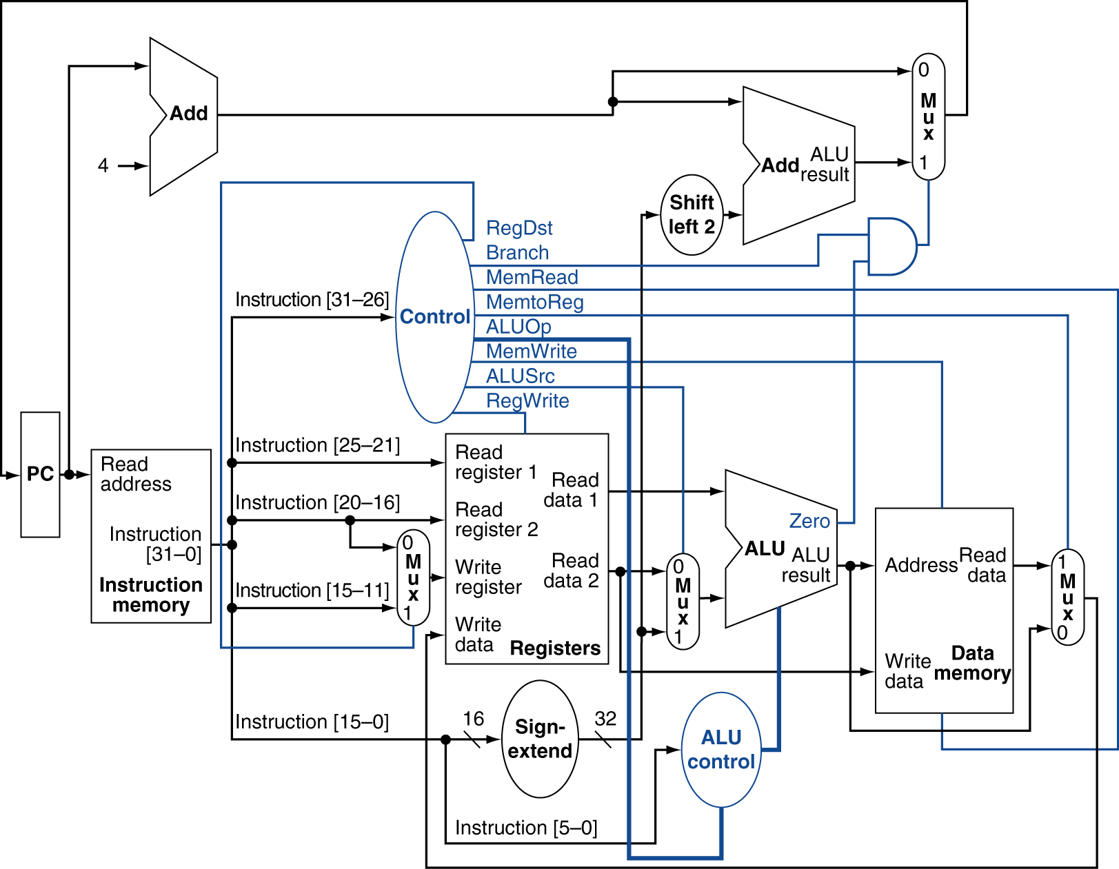
cf. Singleclock Cycle Datapath

Slide 6
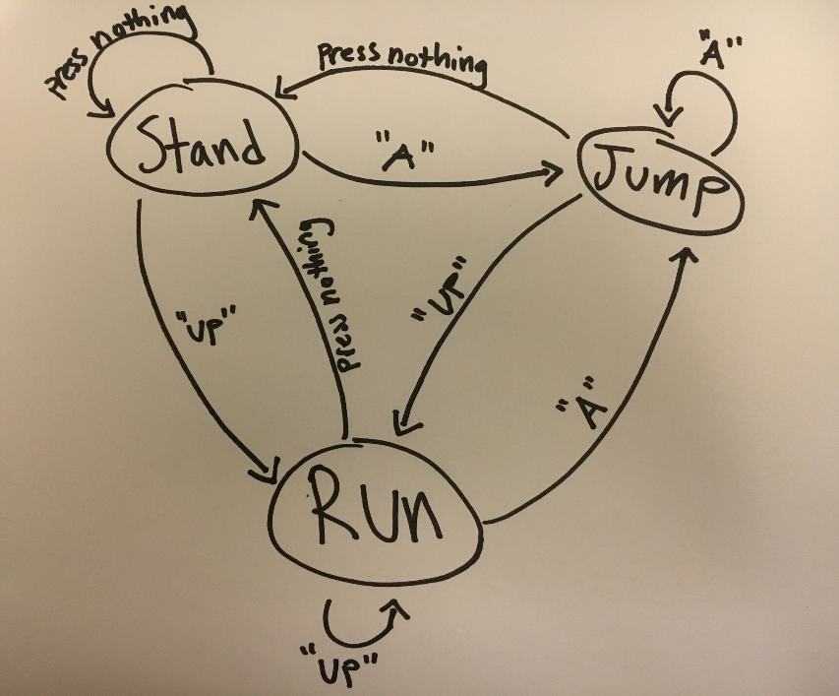
Finite State Machines
A finite state machine (FSM) is a computation model that can be implemented with hardware/software, and can be used to represent sequential logics

Slide 7
Finite State Machines
A finite state machine (FSM) is a computation model that can be implemented with hardware/software, and can be used to represent sequential logics
It can be used as a tool to design/implement the multiclock control unit

Slide 8
Finite State Machines
A finite state machine (FSM) is a computation model that can be implemented with hardware/software, and can be used to represent sequential logics
Here a “state” is a set of control signals at a certain stage (cycle) of an instruction

Slide 9
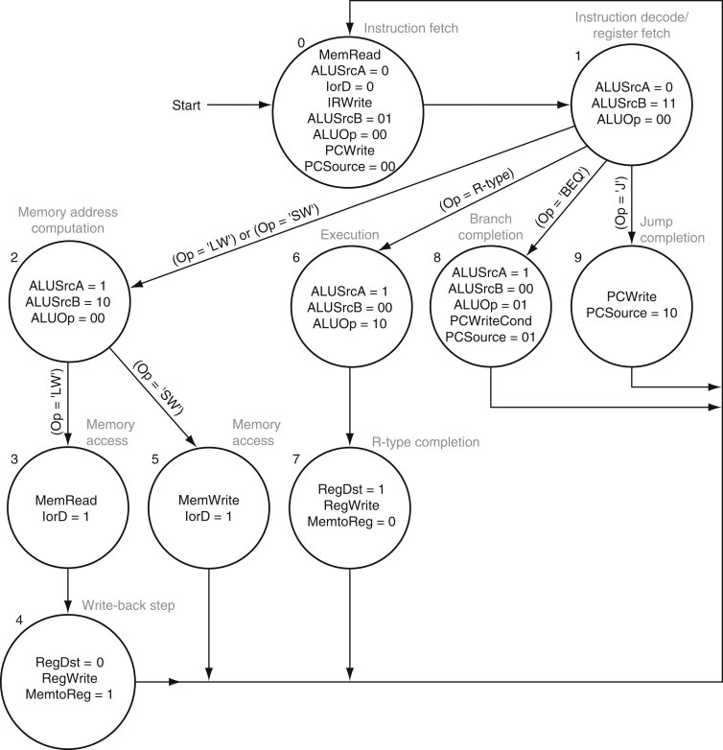
Beginning of instruction
End of instruction
The finite-state diagram for multicycle control
Each circle is the diagram is a “state”
9
Copyright © 2014 Elsevier Inc. All rights reserved.

Slide 10
Finite State Machines
Q: How to represent a “state”?
A: Use a register
Since there are 10 different states, we need a 4-bit register
The 10 states are numbered as 0-9:
state0=0000, state1=0001, state2=0010, state3=0011, state4=0100,
state5=0101, state6=0110, state7=0111, state8=1000, state9=1001

Slide 11
Multiclock Cycle Datapath

Slide 12
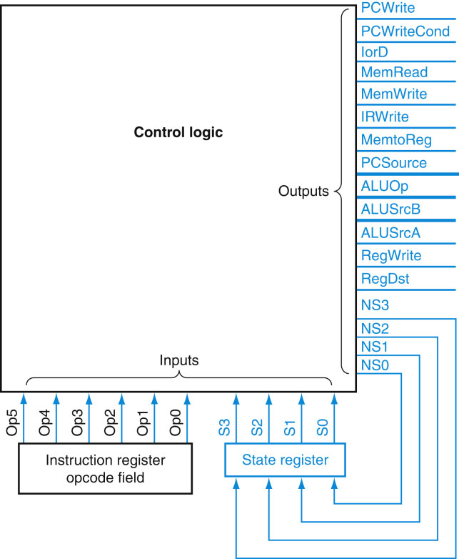
?
FIGURE D.3.2 The control unit for MIPS will consist of some control logic and a register to hold the state. The state register is written at the active clock edge and is stable during the clock cycle
12
Copyright © 2014 Elsevier Inc. All rights reserved.

Slide 13
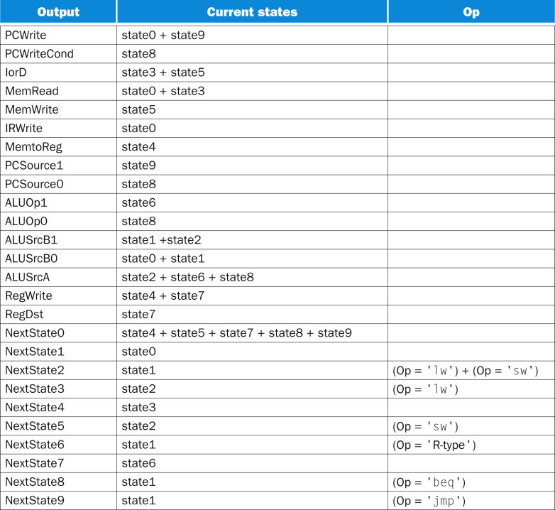

16 Control signals
Next states
+
FIGURE D.3.3 The logic equations for the control unit shown in a shorthand form. Remember that “1” stands for OR in logic equations. The state inputs and NextState outputs must be expanded by using the state encoding. Any blank entry is a don’t care.
13
Copyright © 2014 Elsevier Inc. All rights reserved.

Slide 14
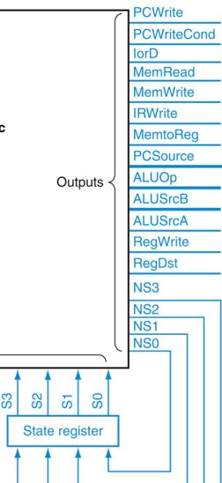
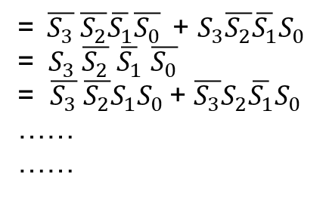
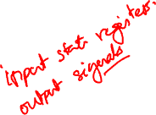
PCWrite = State0 + State9
PCWriteCond = State8
IorD = State3 + State5
MemRead = ……
……
=$\overline{S_{3}} \overline{S_{2}}\overline{S_{1}}\overline{S_{0}}$ + $S_{3}\overline{S_{2}}\overline{S_{1}}S_{0}$
= ${ S}_{3} \overline{S_{2}}$ $\overline{S_{1}}$ $\overline{S_{0}}$
= $\overline{S_{3}} \overline{S_{2}}{S_{1}S}_{0}$+ $\overline{S_{3}}S_{2}\overline{S_{1}}S_{0}$
……
……

Slide 15
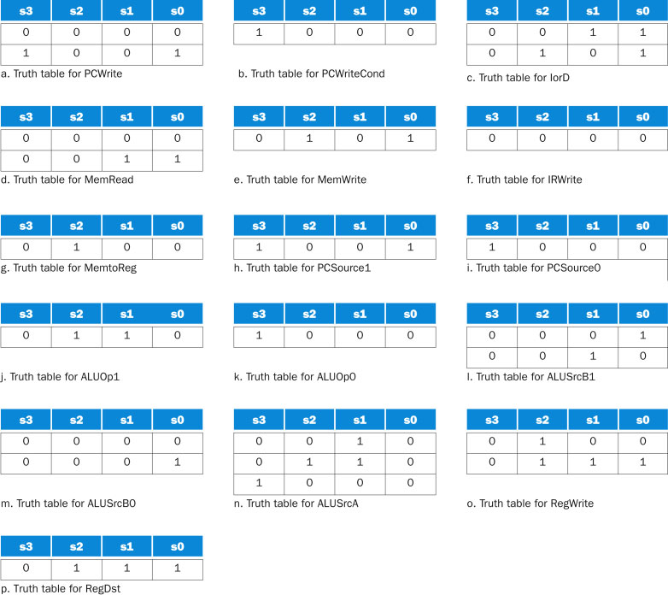
FIGURE D.3.4 The truth tables are shown for the 16 datapath control signals that depend only on the current-state input bits, which are shown for each table. Each truth table row corresponds to 64 entries: one for each possible value of the six Op bits. Notice that some of the outputs are active under nearly the same circumstances. For example, in the case of PCWriteCond, PCSource0, and ALUOp0, these signals are active only in state 8 (see b, i, and k). These three signals could be replaced by one signal. There are other opportunities for reducing the logic needed to implement the control function by taking advantage of further similarities in the truth tables.
15
Copyright © 2014 Elsevier Inc. All rights reserved.

Slide 16
FIGURE D.3.1 The finite-state diagram for multicycle control.
16
Copyright © 2014 Elsevier Inc. All rights reserved.

Slide 17
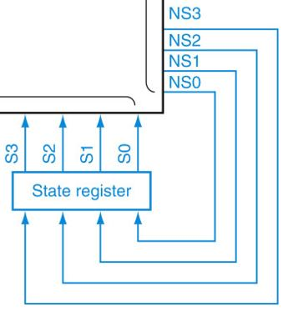

 | NS₃ | NS₂ | NS₁ | NS₀
NextState0 | 0 | 0 | 0 | 0
NextState1 | 0 | 0 | 0 | 1
NextState2 | 0 | 0 | 1 | 0
NextState3 | 0 | 0 | 1 | 1
NextState4 | 0 | 1 | 0 | 0
NextState5 | 0 | 1 | 0 | 1
NextState6 | 0 | 1 | 1 | 0
NextState7 | 0 | 1 | 1 | 1
NextState8 | 1 | 0 | 0 | 0
NextState9 | 1 | 0 | 0 | 1
NS3
NS2
NS1
NS0
NS₀ = NextState1 + NextState3 + NextState5 + NextState7 + NextState9
NS₁ = NextStat2 + NextStat3 + NextStat6 + NextStat7
NS₂ = ……
NS₃ = ……

Slide 18
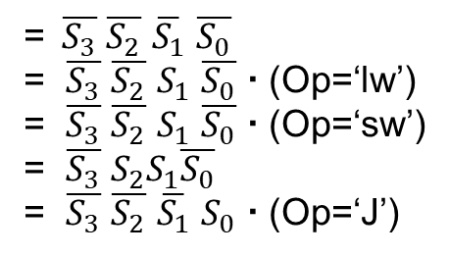
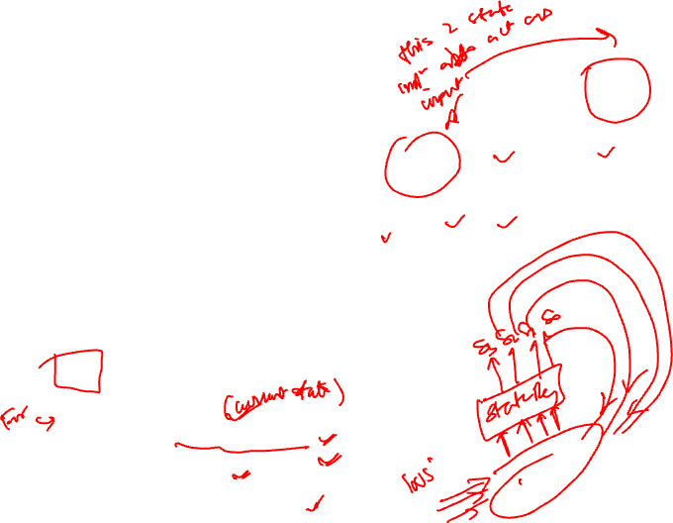
 | NS₃ | NS₂ | NS₁ | NS₀
NextState0 | 0 | 0 | 0 | 0
NextState1 | 0 | 0 | 0 | 1
NextState2 | 0 | 0 | 1 | 0
NextState3 | 0 | 0 | 1 | 1
NextState4 | 0 | 1 | 0 | 0
NextState5 | 0 | 1 | 0 | 1
NextState6 | 0 | 1 | 1 | 0
NextState7 | 0 | 1 | 1 | 1
NextState8 | 1 | 0 | 0 | 0
NextState9 | 1 | 0 | 0 | 1
NS3
NS2
NS1
NS0
NS₀ = NextState1 + NextState3 + NextState5 + NextState7 + NextState9
NextState1 = State0
NestState3 = State2  (Op=‘lw’)
NestState5 = State2  (Op=‘sw’)
NestState7 = State6
NestState9 = State1  (Op=‘J’)
=$\overline{S_{3}}$ $\overline{S_{2}}$ $\overline{S_{1}}$ $\overline{S_{0}}$
= $\overline{S_{3}}$ $\overline{S_{2}}$ $S_{1}$ $\overline{S_{0}}$  (Op=‘lw’)
= $\overline{S_{3}}$ $\overline{S_{2}}$ $S_{1}$ $\overline{S_{0}}$  (Op=‘sw’)
= $\overline{S_{3}}$ $S_{2}S_{1}\overline{S_{0}}$
= $\overline{S_{3}}$ $\overline{S_{2}}$ $\overline{S_{1}}$ $S_{0}$  (Op=‘J’)

Slide 19
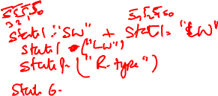
 | NS₃ | NS₂ | NS₁ | NS₀
NextState0 | 0 | 0 | 0 | 0
NextState1 | 0 | 0 | 0 | 1
NextState2 | 0 | 0 | 1 | 0
NextState3 | 0 | 0 | 1 | 1
NextState4 | 0 | 1 | 0 | 0
NextState5 | 0 | 1 | 0 | 1
NextState6 | 0 | 1 | 1 | 0
NextState7 | 0 | 1 | 1 | 1
NextState8 | 1 | 0 | 0 | 0
NextState9 | 1 | 0 | 0 | 1
NS₁ = NextState2 + NextState3 + NextState6 + NextState7
NextState2 = …
NestState3 = …
NestState6 = …
NestState7 = …

Slide 20
 | NS₃ | NS₂ | NS₁ | NS₀
NextState0 | 0 | 0 | 0 | 0
NextState1 | 0 | 0 | 0 | 1
NextState2 | 0 | 0 | 1 | 0
NextState3 | 0 | 0 | 1 | 1
NextState4 | 0 | 1 | 0 | 0
NextState5 | 0 | 1 | 0 | 1
NextState6 | 0 | 1 | 1 | 0
NextState7 | 0 | 1 | 1 | 1
NextState8 | 1 | 0 | 0 | 0
NextState9 | 1 | 0 | 0 | 1

Slide 21
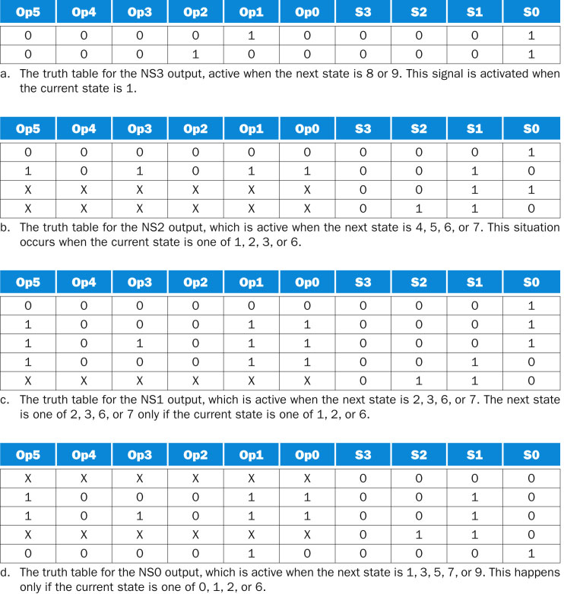
FIGURE D.3.5 The four truth tables for the four next-state output bits (NS[3–0]). The next-state outputs depend on the value of Op[5-0], which is the opcode field, and the current state, given by S[3–0]. The entries with X are don’t-care terms. Each entry with a don’t-care term corresponds to two entries, one with that input at 0 and one with that input at 1. Thus an entry with n don’t-care terms actually corresponds to 2^{n} truth table entries.
21
Copyright © 2014 Elsevier Inc. All rights reserved.

Slide 22
?
FIGURE D.3.2 The control unit for MIPS will consist of some control logic and a register to hold the state. The state register is written at the active clock edge and is stable during the clock cycle
22
Copyright © 2014 Elsevier Inc. All rights reserved.

Slide 24
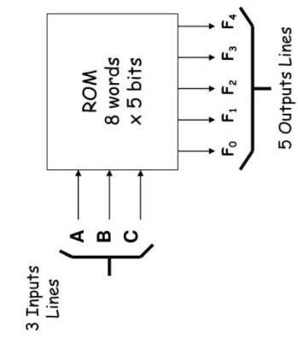
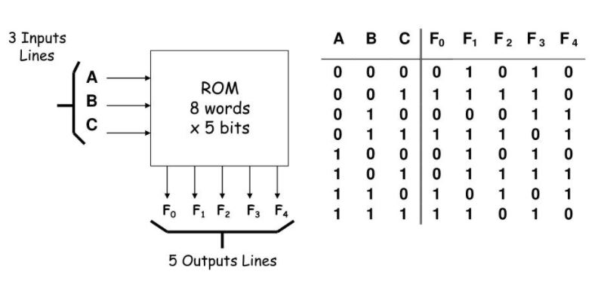
Using Read-Only Memory (ROM)
Address
Content
24
Copyright © 2014 Elsevier Inc. All rights reserved.

Slide 25
Using Read-Only Memory (ROM)
Control Signals
State
25
Copyright © 2014 Elsevier Inc. All rights reserved.

Slide 26
ROM
S3
S2
S1
S0
ROM
FIGURE D.3.2 The control unit for MIPS will consist of some control logic and a register to hold the state. The state register is written at the active clock edge and is stable during the clock cycle
26
Copyright © 2014 Elsevier Inc. All rights reserved.

Slide 27
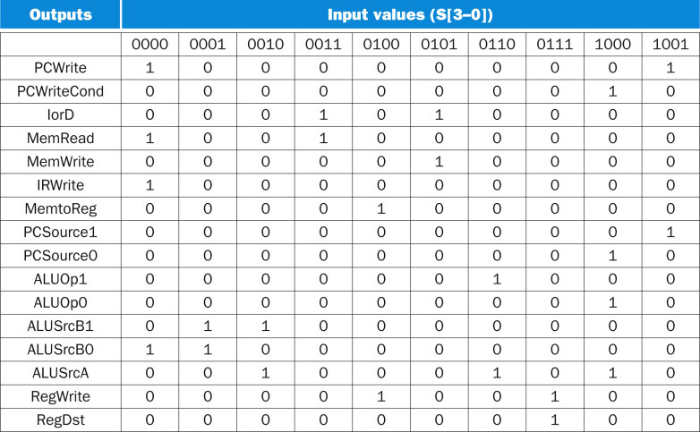

10 States
16
Control signals
FIGURE D.3.6 The truth table for the 16 datapath control outputs, which depend only on the state inputs. The values are determined from Figure D.3.4. Although there are 16 possible values for the 4-bit state field, only ten of these are used and are shown here. The ten possible values are shown at the top; each column shows the setting of the datapath control outputs for the state input value that appears at the top of the column. For example, when the state inputs are 0011 (state 3), the active datapath control outputs are IorD or MemRead.
27
Copyright © 2014 Elsevier Inc. All rights reserved.

Slide 28
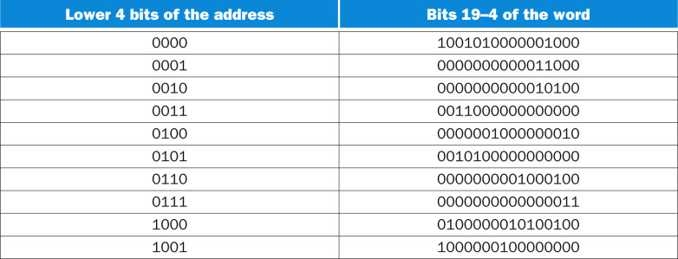
Address = State
Word = Control Signals
FIGURE D.3.7 The contents of the upper 16 bits of the ROM depend only on the state inputs. These values are the same as those in Figure D.3.6, simply rotated 90°. This set of control words would be duplicated 64 times for every possible value of the upper six bits of the address.
28
Copyright © 2014 Elsevier Inc. All rights reserved.

Slide 29
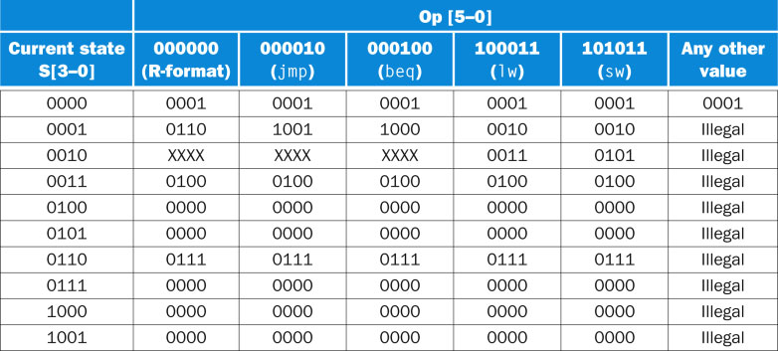
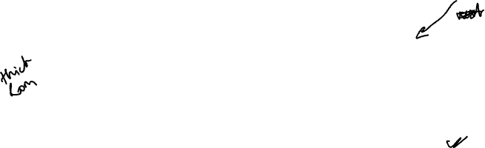
Next states
FIGURE D.3.8 This table contains the lower 4 bits of the control word (the NS outputs), which depend on both the state inputs, S[3–0], and the opcode, Op[5–0], which correspond to the instruction opcode. These values can be determined from Figure D.3.5. The opcode name is shown under the encoding in the heading. The four bits of the control word whose address is given by the current-state bits and Op bits are shown in each entry. For example, when the state input bits are 0000, the output is always 0001, independent of the other inputs; when the state is 2, the next state is don’t care for three of the inputs, 3 for lw, and 5 for sw. Together with the entries in Figure D.3.7, this table specifies the contents of the control unit ROM. For example, the word at address 1000110001 is obtained by finding the upper 16 bits in the table in Figure D.3.7 using only the state input bits (0001) and concatenating the lower four bits found by using the entire address (0001 to find the row and 100011 to find the column). The entry from Figure D.3.7 yields 0000000000011000, while the appropriate entry in the table immediately above is 0010. Thus the control word at address 1000110001 is 00000000000110000010. The column labeled “Any other value” applies only when the Op bits do not match one of the specified opcodes.
29
Copyright © 2014 Elsevier Inc. All rights reserved.

Slide 30
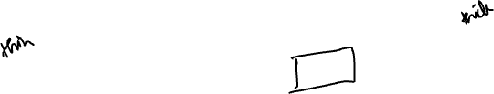
16
…
…
Control
NextState
ROM
ROM
State
f₅ - f₀
State
2⁴ = 16 addresses
10 have contents
2¹⁰ = 1024 addresses
< 60 have contents
(only ~5% addresses used)

Slide 31
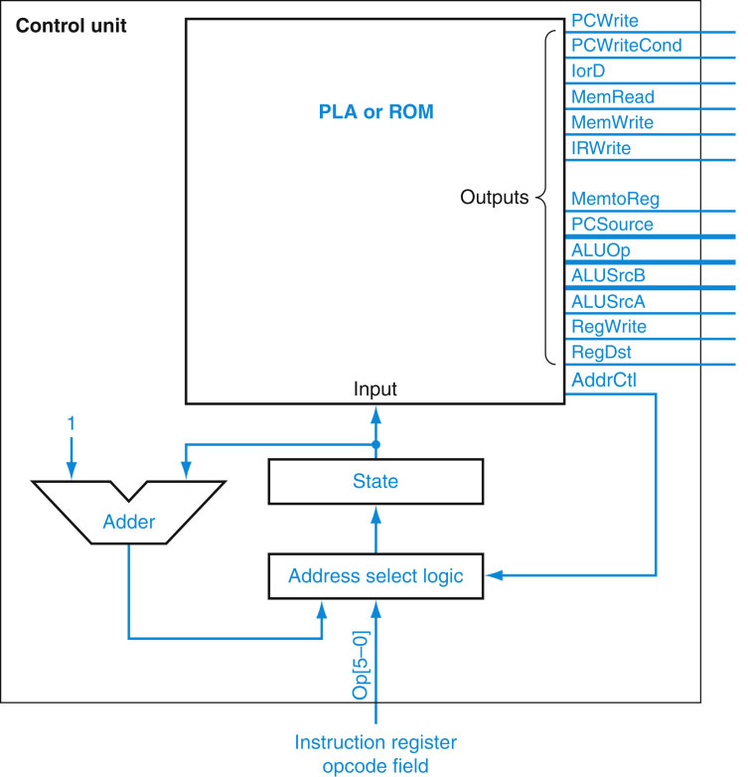
Refined design
for NextState
State (0000-1001)
NextState (0000-1001)
FIGURE D.4.1 The control unit using an explicit counter to compute the next state. In this control unit, the next state is computed using a counter (at least in some states). By comparison, Figure D.3.2 encodes the next state in the control logic for every state. In this control unit, the signals labeled AddrCtl control how the next state is determined.
31
Copyright © 2014 Elsevier Inc. All rights reserved.

Slide 32
FIGURE D.3.1 The finite-state diagram for multicycle control.
32
Copyright © 2014 Elsevier Inc. All rights reserved.

Slide 33
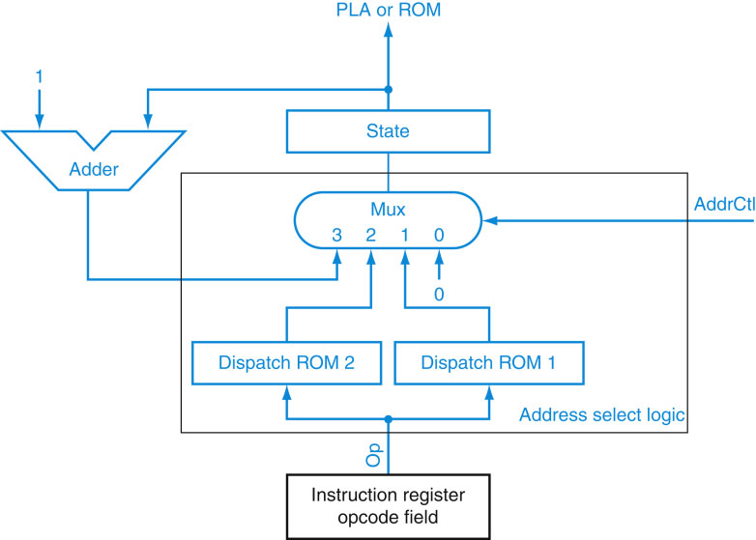

NextState (0000-1001)
FIGURE D.4.2 This is the address select logic for the control unit of Figure D.4.1.
33
Copyright © 2014 Elsevier Inc. All rights reserved.

Slide 34
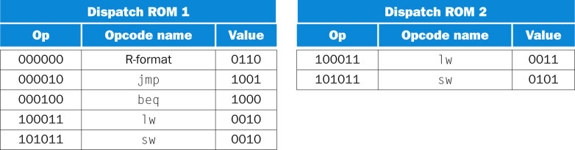

When State1
When State2
FIGURE D.4.3 The dispatch ROMs each have 2⁶ 5 64 entries that are 4 bits wide, since that is the number of bits in the state encoding. This figure only shows the entries in the ROM that are of interest for this subset. The first column in each table indicates the value of Op, which is the address used to access the dispatch ROM. The second column shows the symbolic name of the opcode. The third column indicates the value at that address in the ROM.
34
Copyright © 2014 Elsevier Inc. All rights reserved.

Slide 35
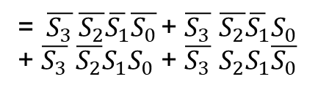
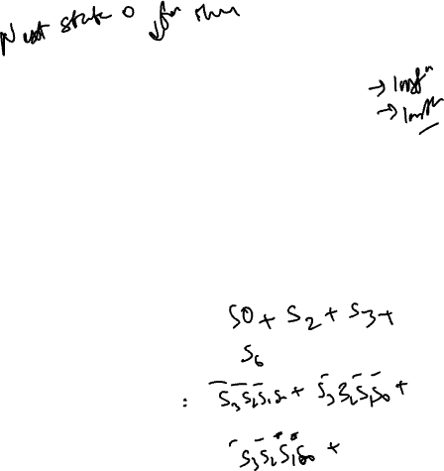
AddrCtl
00: NextState = 0 – State4 + State5 + State7 + State8 + State9
01: NextState from ROM1 – State1 (depending on Op-code)
10: NextState from ROM2 – State2 (depending on Op-code)
11: NextState = State++ – State0 + State3 + State6
State | AddrCtl
0000 | 11 (3)
0001 | 01 (1)
0010 | 10 (2)
0011 | 11 (3)
0100 | 00 (0)
0101 | 00 (0)
0110 | 11 (3)
0111 | 00 (0)
1000 | 00 (0)
1001 | 00 (0)
AddrCtl₀ = State0 + State1
+ State3 + State6
=$\overline{S_{3}} \overline{S_{2}}\overline{S_{1}}\overline{S_{0}}$ + $\overline{S_{3}}$ $\overline{S_{2}}\overline{S_{1}}S_{0}$
+ $\overline{S_{3}}$ $\overline{S_{2}}S_{1}S_{0}$ + $\overline{S_{3}}$ $S_{2}S_{1}\overline{S_{0}}$
AddrCtl₁ = ?

Slide 36
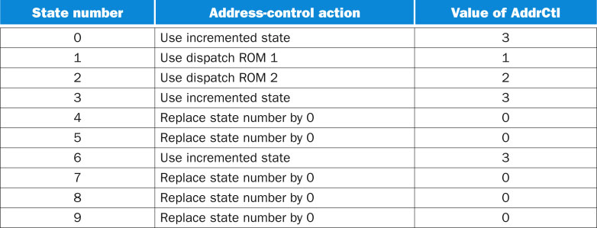
FIGURE D.4.4 The values of the address-control lines are set in the control word that corresponds to each state.
36
Copyright © 2014 Elsevier Inc. All rights reserved.

